Slide 1
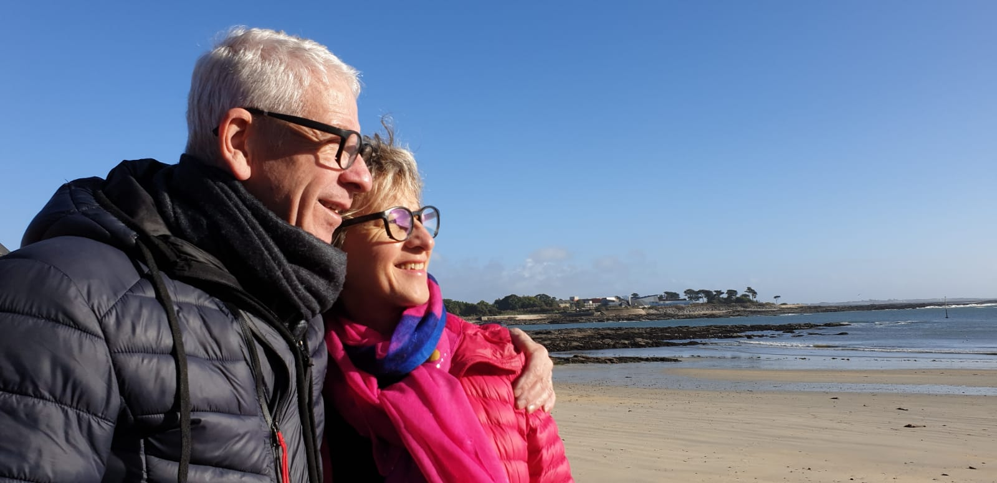
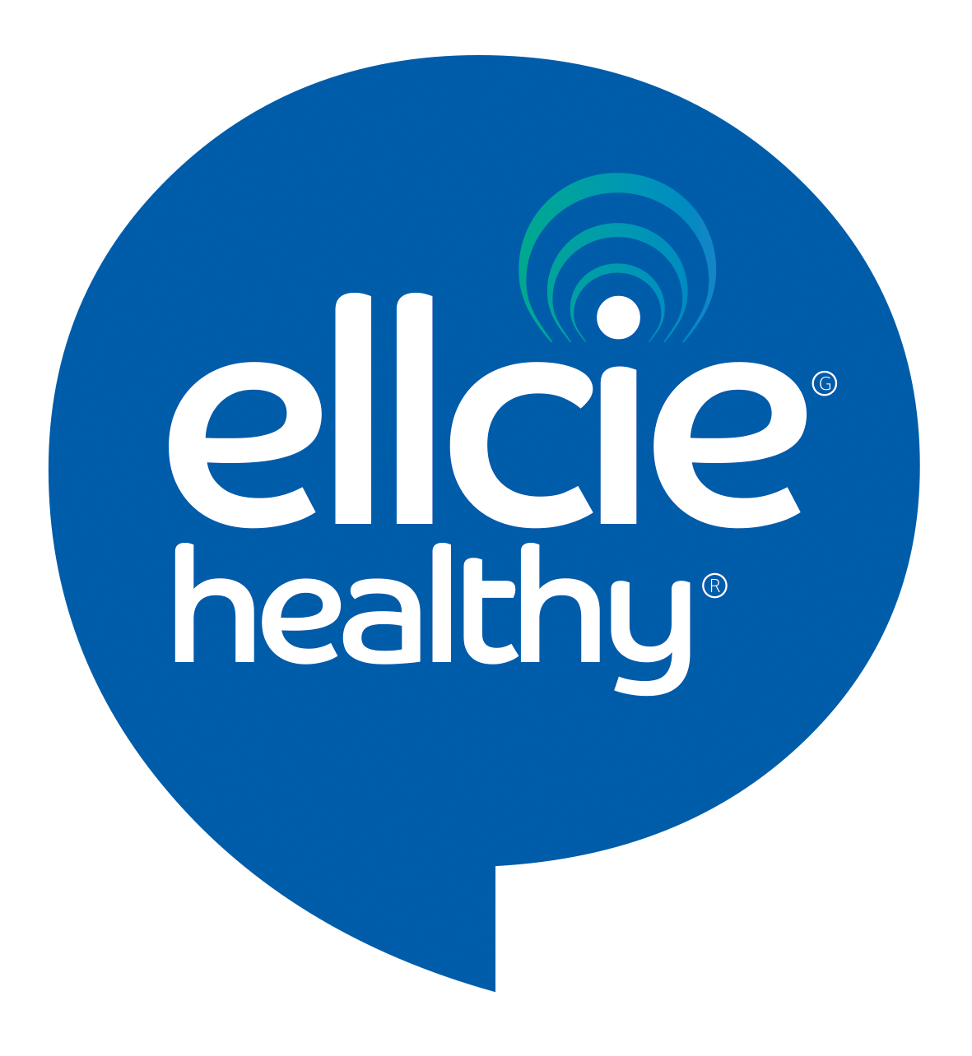
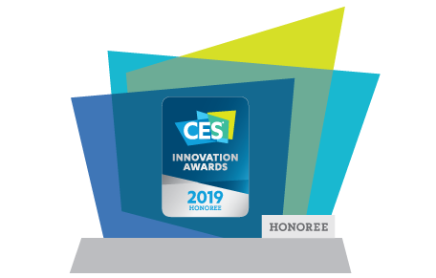
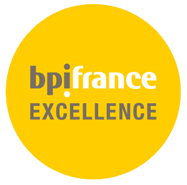
Smart Glasses using AI to look after people
Smart & affordable in place solution
966648, GlaaS
Open sensing eyewear for a daily health monitoring

Slide 2
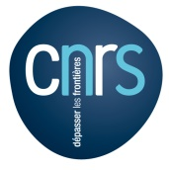
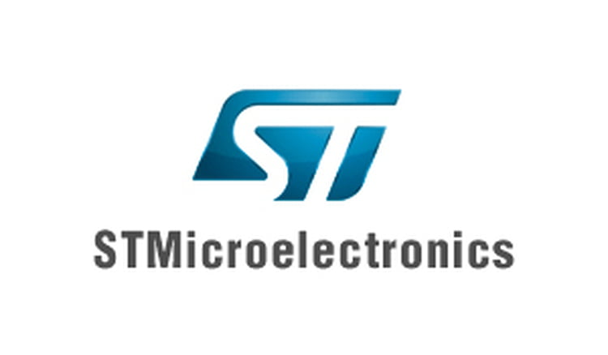
Ellcie Healthy at a glance
6
YEARS OF EXISTENCE
20
SENSORS EMBBEDED IN OUR FRAMES WITH AN AUTONOMY OF 24 HOURS
12
LABORATORIES AND HOSPITALS ACTIVELY WORKING WORLDWIDE WITH ELLCIE HEALTHY
SOME OF OUR CORPORATE CUSTOMERS
OUR LABORATORIES PARTNERS
20
FILED PATENTS FOR EU & US MARKETS
6
MILLION EUROS ALREADY INVESTED TO LAUNCH OUR PRODUCTION
>30
CORPORATE CUSTOMERS
AND CONFIRMED ORDERS
(15,000 UNITS OF OUR GEN1 EYEWEAR ALREADY SOLD)
MANY DISTINCTIONS AND ENCOURAGING AWARDS
Prix Innovation
2019
2

Slide 3
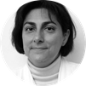
THE LEADING TEAM :
PHILIPPE PEYRARD CEO
25 years experience in optical & luxury sectors
(L’Oréal, L’Amy, Atol).
PR DOMINIQUE BREMOND MD
Medical Doctor, PhD
Professor & Chief of the Ophthalmology Department at Necker Hospital in Paris.
Searcher at CNRS.
OUR STRATEGIC COMMITTEE
.

Slide 4
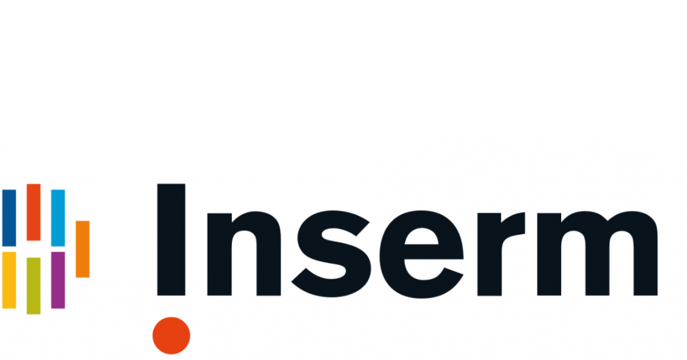
SCIENTIFIC PARTNERS
25 more People working for Ellcie Healthy including 20 PhD’s
CNRS FR 3636
Binocular vision research laboratory attached to the CHU Necker of the ophthalmology department.
Kansas University Medical center - USA
LEAT
Research Lab addressing antennas and miniaturisation matters…
Hospital Nice Cimiez
Specialists on geriatric issues
LAMHESS
UFR STAPS’s Lab
Data research on sport and dependency.
Hospital Princesse Grâce
In collaboration with the LEAT and Hospital Princess Grace, Ellcie Healthy studies the impact of radiation on the human body. Monaco
INRIA
Construction of algorithms or appropriation of the data feeding the Artificial Intelligence of the connected object.
University Hospital Carl Gustave Carus
specialists on neurodegenerative disease- Germany
Sleep Center
Under the supervision of Pr Damien LEGER, member of the expert committee for road safety, the Sleep institute tests the positive impacts of solutions on the drowsiness and driving.
Public Hospital Barthelemy Durand
specialists on psychiatric disease
Inserm
Pr Brémond 1138 team 17 Sorbonne Université
Emory school of medicine
Study together with NextSense and TAKEDA pharmaceuticals on narcolepsia - USA

Slide 5
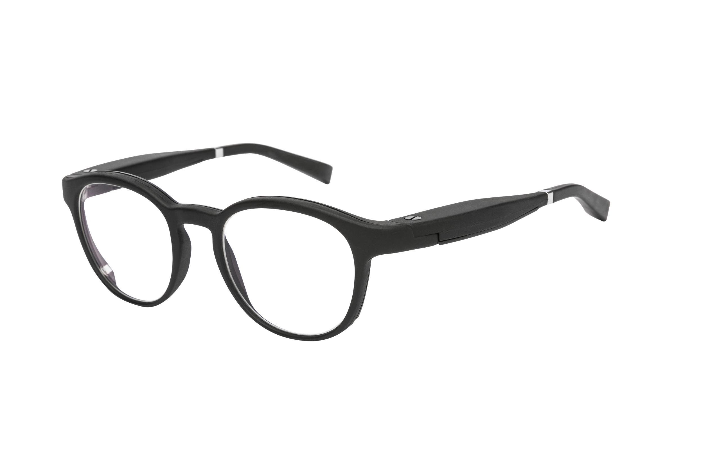
OUR PATENTED TECHNOLOGY
PROPRIETARY DEVICE
Ambient temperature sensors
PATENTS IN THE US AND EU
Atmospheric pressure sensor
20 PATENTS FILED
10 PATENTS ALREADY GRANTED
Buzzer
Accelerometer & gyroscope
LEDs RGB (2)
CERTIFICATION UL AND CE
LEDs RGB (1)
Infrared sensors
Battery charging spot
PROOF OF CONCEPT
Battery
We developed a proof of concept to embed a Body Temperature Measurement Sensor inside the frame

Slide 6
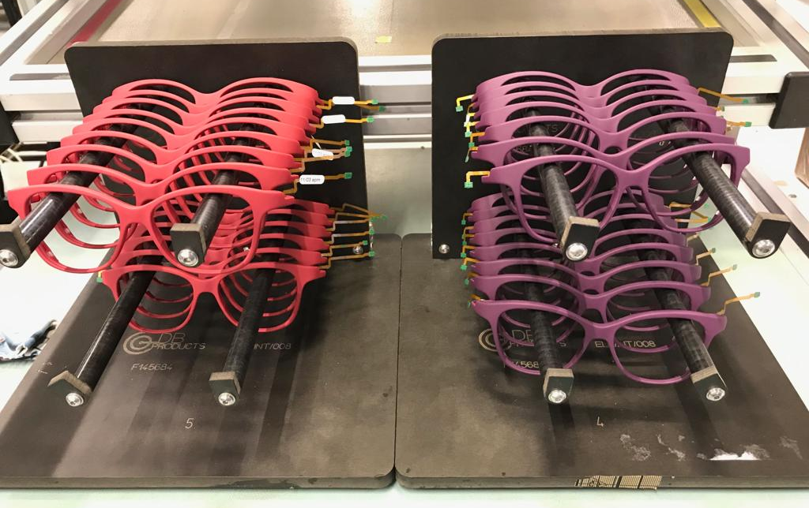
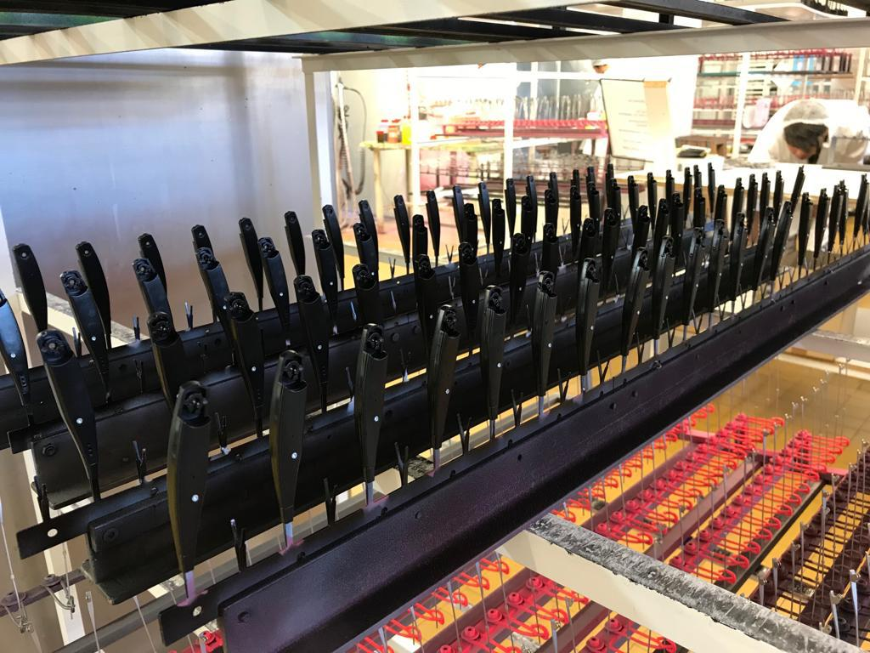
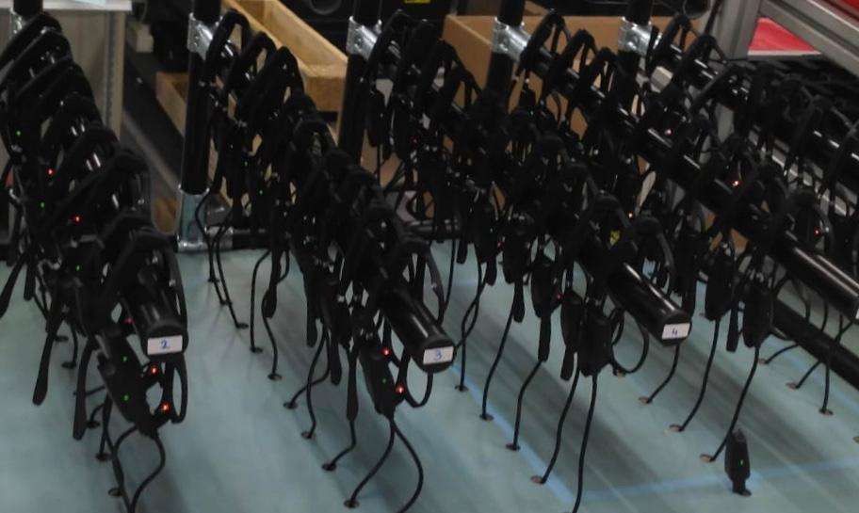
OUR FRENCH-BASED INDUSTRIAL PARTNERS
High quality
Secured Intellectual Property
Scalable (plants on 5 continents)
Made in France
6
6

Slide 7
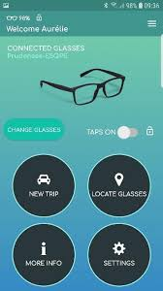
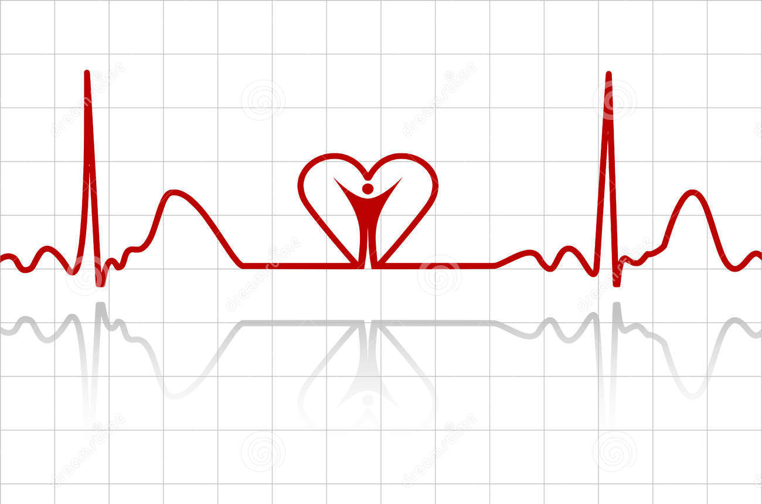
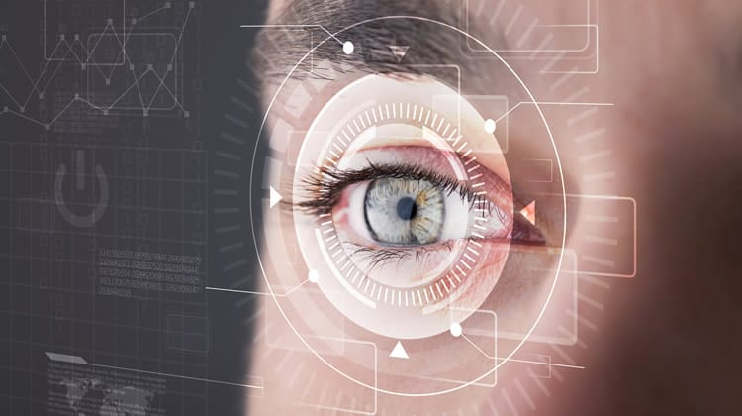
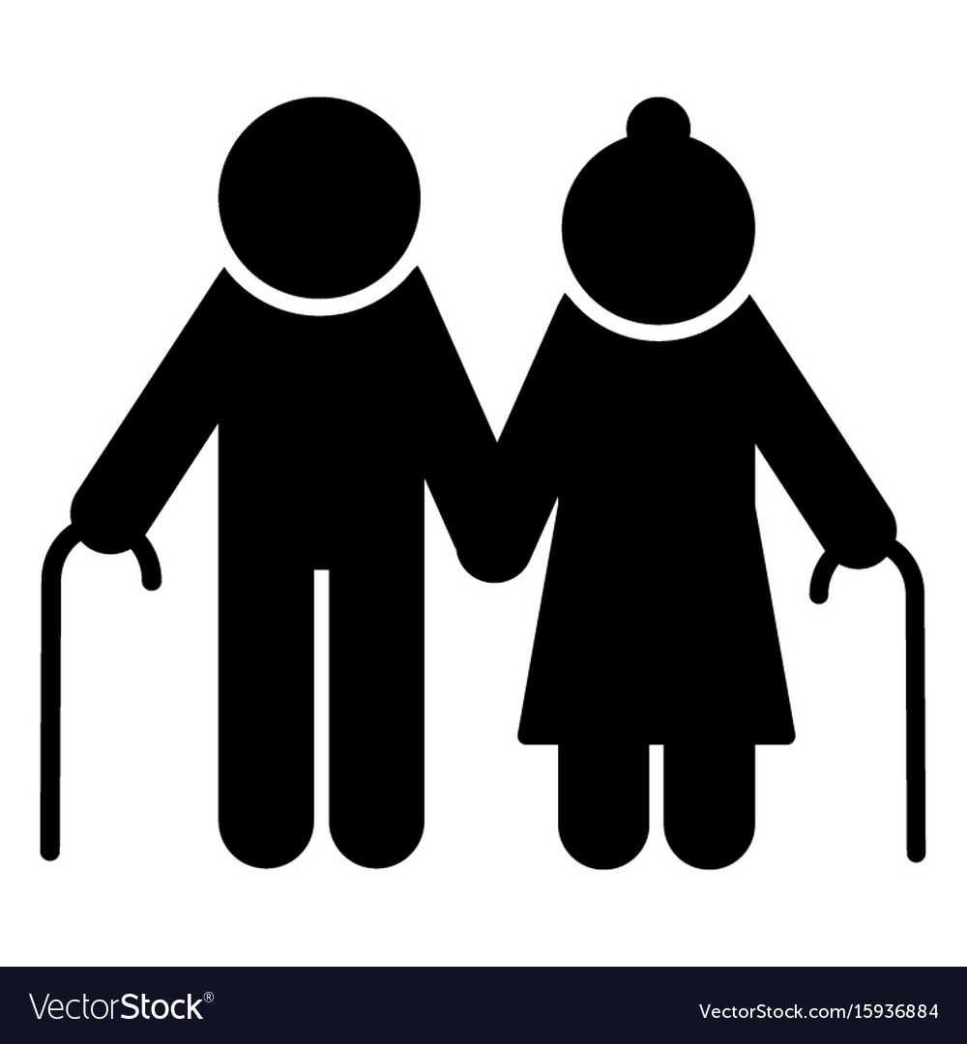
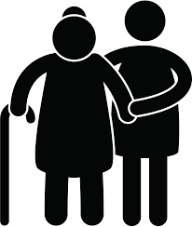
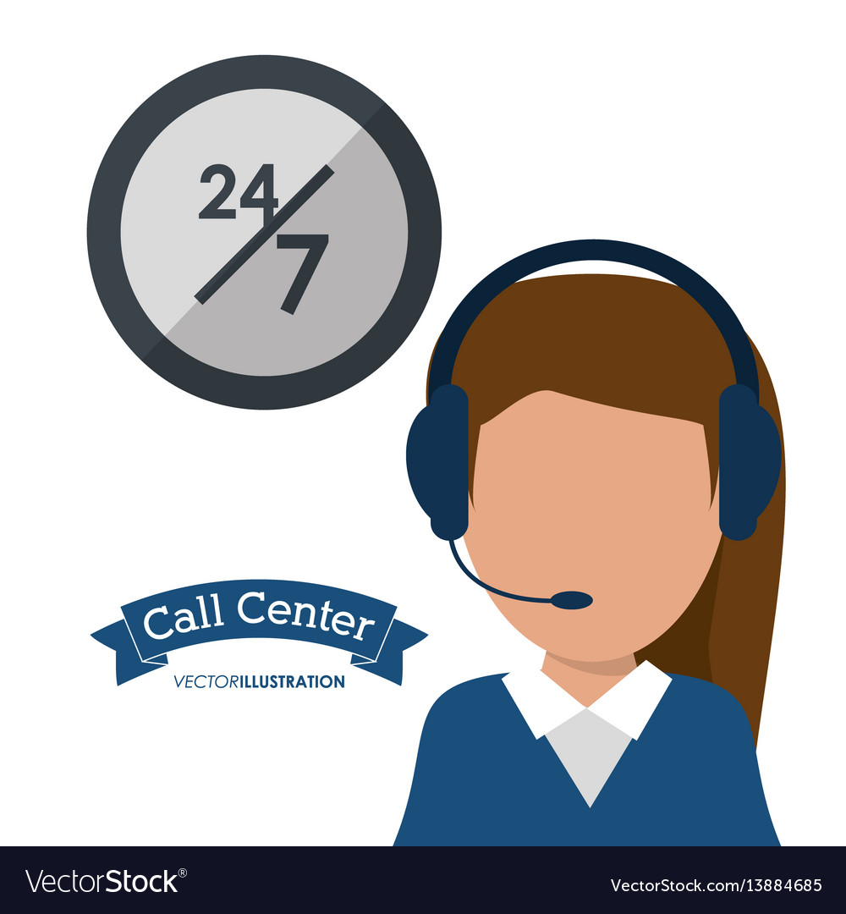
Daily physical and physiological monitoring
ALL IN ONE IN PLACE SOLUTION
Received awards
Approved by Centre du Sommeil + Streetlab Institut de la Vision
Validated by Hospitals for patients monitoring
#1 wearable according toTASDA’s clinical tests
Worldwide innovation
Activity & Eye tracking
Fall detection
Locate glasses
Drowsiness detection
Fall prevention
Cardio/ Temperature monitoring
HIGH ADDED VALUE FOR EVERYONE :
Elderly people
(final users)
Insurance companies
(distributors)
Caregivers companies
(distributors)
Assistance companies
(distributors)
Convenient, non-intrusive safety monitoring in order to live better and longer
Lower costs and higher margin thanks to risk detection and reduction
Higher margin (our efficient automation reduces need for actual people on the ground)
Increase margin (< 5% false alarm compared to 80% for other fall detection devices)

Slide 8
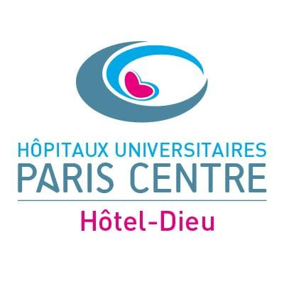
CLINICAL & TECHNICAL TRIAL’S VALIDATION
Ellcie Healthy has systematized the clinical tests to validate the effectiveness of its device on the developed use cases. The first use case have gone through the following tests and validation :
Drowsiness detection
at the wheel
Fall detection and
Fall prevention
Sight monitoring
Proof of Concept
2017-2019
Detection of warning signs of drowsiness (eye blinks analysis)
2019 - 2021
Detection of hard and soft falls
Fall prevention based on a stability index and its evolution
2019 - 2020
Sight monitoring and precision management based on Ellcie Healthy’s eyeglasses
Developments
Medical / technical third-party reference
French Airforce - DGA
2018 : Tested by the teams of Pr AJ Sahel (StreetLab / Sleep Institute) and by the Sleep Center and the teams of Pr Damien Léger
Prof. Brémond (CNRS)
2019 : TASDA test protocol on fall detection devices
2020 : Validation of a POC for sight monitoring with <2° angle precision using Ellcie Healthy’s eyetracking technology.
Development of fall prevention algorithms with the teams of Pr O. Guerrin (CHU Nice) and Pr S Colson (LAMHESS)
8

Slide 9
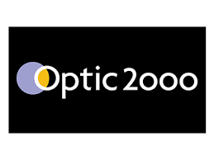
MARKET TRACTION - OUR FIRST CUSTOMERS
15 000 UNITS already SOLD (November 2022)
INSURANCES
HEALTH ORGANISATIONS (PRIVATE & PUBLIC)
Reduce risks for their subscribers
Reduce accidents costs
Innovate through disruptive approach
Reduce costs through automated surveillance
Increase margin thanks to better detection efficiency
Conduct experiment and gather data
CORE
CORPORATIONS
OPTICAL DISTRIBUTORS
Secure their employee and increase employees’ loyalty
CSR Corporate Social Responsability Regulation on workers in the field
Product differentiation & Innovation
Branding & Image
Developing recurring revenues
Develop B2B actions (local bus companies…)
SECONDARY
9

Slide 10
Our expectations
Business
Fundings

Slide 11
CONTACT
Philippe PEYRARD, CEO
pp@ellcie-healthy.com
+33 678 06 81 62
Website : https://ellcie-healthy.com/
https://twitter.com/EllcieHealthy
https://www.facebook.com/ellciehealthy
https://www.instagram.com/ellcie_healthy/
https://www.linkedin.com/company/ellcie-healthy-sas/

